Slide 1

Voice Stick
Michael Shechter
Sagie Levy
Advisor: Andrei Sharf
המחלקה למדעי המחשב, אוניברסיטת בן גוריון בנגב

Slide 2
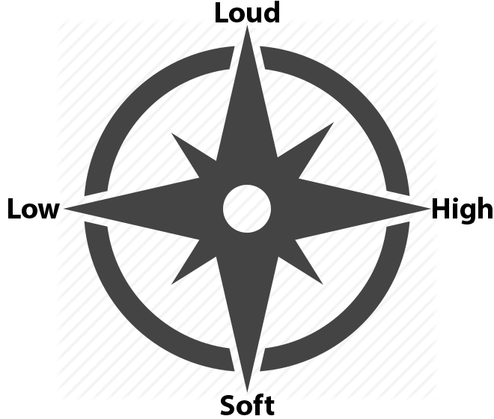
Overview:
Voice stick is an voice based controller.
It analyzes user’s voice and represents it as a controller input.
The voice is interpreted in two axes:
The Y axis represents the volume of the user’s voice, ranging from very soft to very loud.
The X axis represents the pitch of the user’s voice, ranging from low to high.

Slide 3
User Calibration:
What does it mean to represent the voice of the user as controller input?
Before using the controller it must be calibrated for a new user.
The user’s vocal range and volume is recorded.
When using the controller, the input value is relative to the calibration of the user.

Slide 4
Voice Analysis:
We use Fourier Transform to convert the analog data from the microphone to digital data we can analyze - An array of frequencies (the index in the array represents the frequency, and the value represents its amplitude)
We then calculate both the decibel of the user’s voice, and their pitch.

Slide 5
Decibels
First we calculate the RMS (Root Mean Square).
Then we convert to decibels using decibel equation - an approximation of how the the human ear’s sensitivity to sound.
Example: There is a big difference between a tiny whisper to a soft voice, but there is a small difference between the roar of a jet engine and standing close to a speaker in a party.

Slide 6
Pitch Detection
You would like to think that the frequency with the highest amplitude is the pitch. Unfortunately, this isn’t necessarily the case.
An important thing to note when analyzing human speech, is that humans speak in overtones.
Our vocal cords produce overtones, which are multiples of the fundamental frequency. The fundamental tone and its overtones have the highest amplitude from the sampled frequencies.
Usually one of the overtones will have the highest amplitude and not the fundamental frequency itself. We need the fundamental frequency.

Slide 7
Pitch Detection
Since the overtones are multiples of the fundamental frequency, we simply need to find the GCD of our loudest frequencies. Our brain interprets voice roughly this way (Missing Fundamentals https://www.youtube.com/watch?v=t-iWKvh6Fbw).
Example: The loudest frequencies we sampled are: 10, 30, 40, 50, 80, 100.
It’s easy to see the the GCD of these numbers is 10, which is the fundamental frequency.

Slide 8
Questions?

